Slide 1

Database & Database Applications
Chapter 5:Relational Database Design ERD-to-Relational Mapping

Slide 2
Outline
Mapping ERD to Relational Schema
  Mapping Regular/Strong Entity Type
  Mapping Weak Entity Type
  Mapping Binary 1:1 Relationship
  Mapping Binary 1:N Relationship
  Mapping Binary N:M Relationship
  Mapping Multi-Valued Attributes
  Mapping Composite Attributes
  Mapping N-Ary Relationship
  Mapping Recursive Relationship Type

Slide 3
Mapping ERD to Relational Schema
In Database Mapping is converting ER diagram into Relational Schema (Relational Model).
In converting process we care about:
  Number of Entity Types in a relationship.
  Type of Relationship.
  Type of Entity type.
  Type of Attribute.
  Cardinalities.

Slide 4
Cardinality Ratio
The Cardinality of a set is a measure of the “number of elements of the set”.
Cardinalities for binary relationships:
  1:1
  1:N or N:1
  N:M

Slide 5
Mapping Strong Entity Type
Create a relation for each strong entity type
  include all simple attributes
  choose a primary key
C_name
Term
Course no
Section no
1
offered in
N
Course
Section
Description
Credit hours
Meeting

Slide 6
We create a relation for Course - four attributes, course_no is the PK.
C_name
Term
Course no
Section no
1
offered in
N
Course
Section
Description
Credit hours
Meeting
Course
Course_no
C_name
Credit_hours
Description

Slide 7
2. Mapping Weak Entity Type
Create a relation for each weak entity type
    include primary key of owner (as FK)
    Owner’s PK + partial key become the PK
    include all simple attributes
Term
Course no
C_name
Section no
1
offered in
N
Course
Section
Description
Credit hours
Meeting

Slide 8
We create a relation for Section
C_name
Term
Course no
Section no
1
offered in
N
Course
Section
Description
Credit hours
Meeting
Section
PK is {Course_no, Section_no}.
Course_no is a FK.
Meeting is not a simple attribute, so it’s not included.
Course_no
Section_no
Term

Slide 9
3. Mapping Binary 1:1 Relationship
For each binary 1:1 relationship:
  Choose an entity and include the other’s PK in it as a FK.
  Add any simple attributes on the relationship.
Dname
StartDate
SSN
Ename
D_no
1
manages
1
Department
Employee
There are two choices here: Department or Employee
Which is the better choice?

Slide 10
Department is the better choice since it has total participation.
StartDate
SSN
Ename
Dname
D_no
1
Manages
1
Department
Employee
Department
D_no
Dname
MgrSSN
MgrStartDate
If we choose department then Employee SSN is included as a FK named (MgrSSN).
Note that MgrSSN must have a value.

Slide 11
It is better to have the Foreign Key (FK) on the relation that has a total participation, why? (No null values) (Saving Space).
Some employees are not managers.
Department
Dnumber | Dname | MgrSSN | Mgrstartdate
1 | CS | 10 | 21-Apr-80
2 | CIS | 13 | 18-Jan-82
Employee
Fname | Minit | Lname | SSN | Salary | DepNumber | Mgrstartdate
Ahmad | M | Mazen | 10 | … | 1 | 21-Apr-80
Sara | S | Salam | 11 | … | Null | Null
Farah | G | Talal | 12 | … | Null | Null
Kamal | R | Lafi | 13 | … | 2 | 18-Jan-82

Slide 12
4. Mapping Binary 1:N Relationship
For each binary 1:N relationship, choose the n-side entity and include a FK w.r.t the other entity.
Dname
SSN
Ename
D_no
1
Works_in
N
Department
Employee
We must choose Employee
We end up with:
Note that Step 1 would lead to the Employee relation - we have now augmented Employee with the D_no attribute.
Employee
SSN
Ename
D_no
PK is SSN
D_no is an FK

Slide 13
Question
In mapping 1:N relationship, why do you put the foreign key on the N-side? (eg. Employee works_for Department)
Foreign Key on the N-side
Foreign Key on the 1-side
Employee
Department
Dno | … | Name | SSN
1 | … | Kamal | 1
1 | … | Hala | 2
2 | … | Sameh | 3
SSN | Dname | Dnumber
1 | CS | 1
1 | CS | 1
3 | Math | 2
The ordinary primary key “Dnumber” is not
a primary key any more.

Slide 14
5. Mapping Binary M:N Relationship
For each binary M:N relationship, create a relation for the relationship
  include PKs of both entities and any attributes of the relationship
  PK is the concatenation of the participating entities’ PKs
Student_no
Course_no
Grade
Student
m
n
Course
Enroll
Enroll
PK is {Student_no, Course_no}
Student_no is a FK
Course_no is a FK
Grade is an attribute of Enroll
Student_no
Course_no
Grade

Slide 15
Note about relationship attributes
As you have seen from previous examples, relationship attributes always go to the same table in which you put foreign keys resulted from mapping that relationship.

Slide 16
6. Mapping Multi-Valued Attribute
For each multi-valued attribute, create a new relation:
  include the PK attributes of the entity type
  PK is the PK of the entity type and the multi-valued attribute
course no
name
Section no
term
1
offered in
N
course
section
description
credit hours
meeting
Meeting is a multi-valued attribute

Slide 17
Create a relation for meeting
Section was created because of Step 2 - its PK is {course_no, section_no}
meeting
Meeting
PK is {course_no, section_no, meeting}.
Meeting is an all-key relation.
Course_no
Section_no
Meeting

Slide 18

Another Example:
==> Book (ISBN, Title, Publisher)
Book_Authors (ISBN, Author)
Define Book_Authors.ISBN as a foreign key referencing Books.ISBN

Slide 19
Question
Why do not we map the multi-valued attribute on the same entity type relation that it belongs to?
Book
Book
Publisher | Title | ISBN
ABC | Science | 111
XYZ | Math | 222
Author | Publisher | Title | ISBN
Ahmad | ABC | Science | 111
Saeed | ABC | Science | 111
Salma | XYZ | Math | 222
Book_Authors
Author | ISBN
Ahmad | 111
Saeed | 111
Salma | 222
ISBN is not a primary key anymore.
But it should be a primary key for
Book. So, we must map the multi-valued attribute into a separate relation.

Slide 20
7. Mapping Composite Attribute
For each composite attribute:
  include only the simple attributes (of the composite attribute) to the same entity type relation that it belongs to
Student_no
DoB
First_name
St_name
Mid_name
Student
Surname
Student
Student_no
First_name
Mid_name
Surname
DoB

Slide 21
8. Mapping N-ary Relationship
For each n-ary relationship, create a relation for the relationship
  include PKs of all participating entities and any attributes of the relationship
  PK will be the concatenation of the participating entities’ PKs
Semester_no
Course_no
Room
Semester
m
n
Course
offers
p
Instructor
Instr_no

Slide 22
We need one relation, offers, with PK of {Semester_no, Course_no, Instr_no}
semester_no
Course_no
Room no
Semester
m
n
Course
Offers
p
Instructor
Instr_no
Offers
Course_no
Instr_no
Semester_no
Room_no

Slide 23
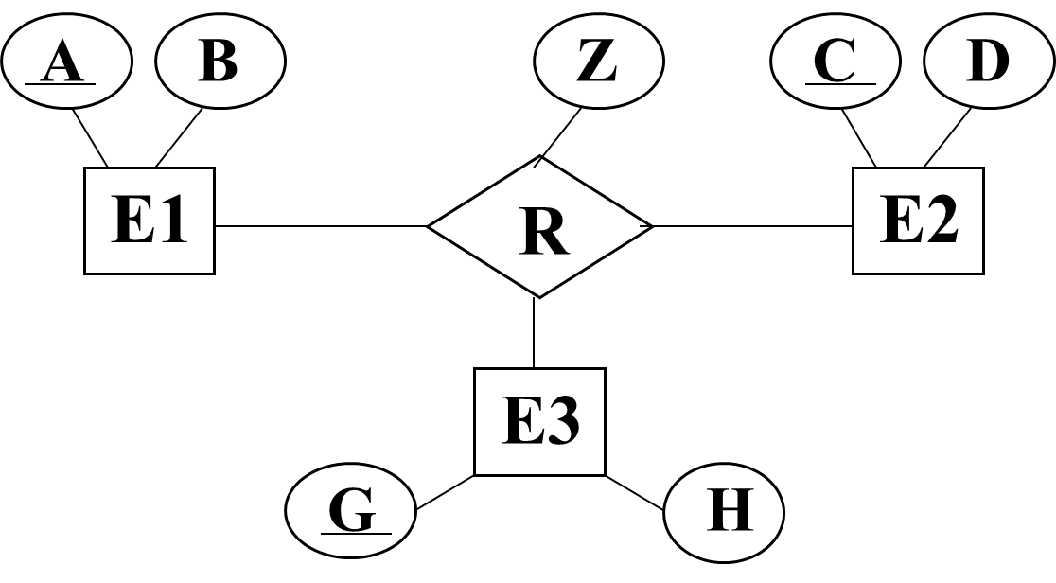
Another Example:
==> E1(A, B), E2(C, D), E3(G, H)
R(A, C, G, Z)

Slide 24
9. Mapping Recursive Relationship
For each recursive relationship
  Transform the recursive relationship into a binary relationship
  Apply the rules for transforming binary relationships:
    For 1:1or 1:N recursive relationship, add a FK to the same entity type (Rename the FK)
    For 1:M recursive relationship, create a new relation
    See the examples for all the three types

Slide 25
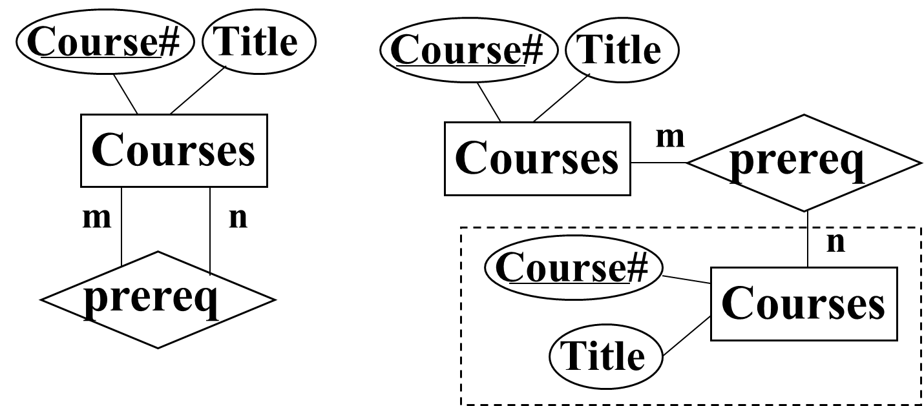
Example of mapping M:N recursive relationship:
Course (Course#, Title)
Prereq_Course (Course#, Prereq-Course#)

Slide 26
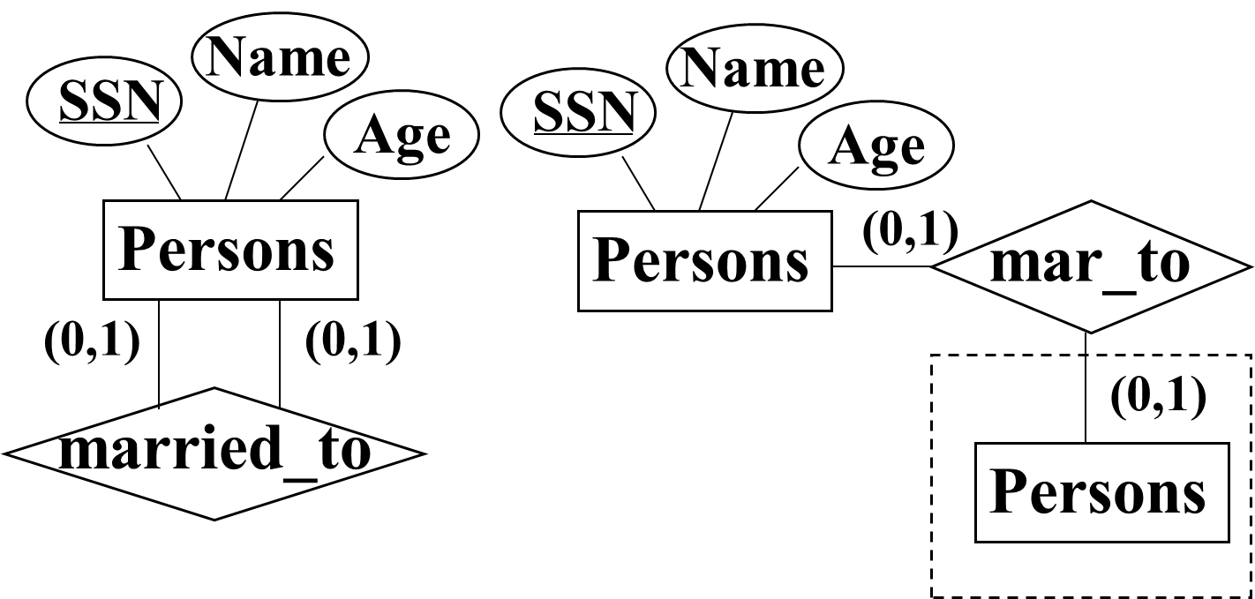
Example of mapping 1:1 recursive relationship:
Person (SSN, Name, Age, Spouse_SSN)

Slide 27
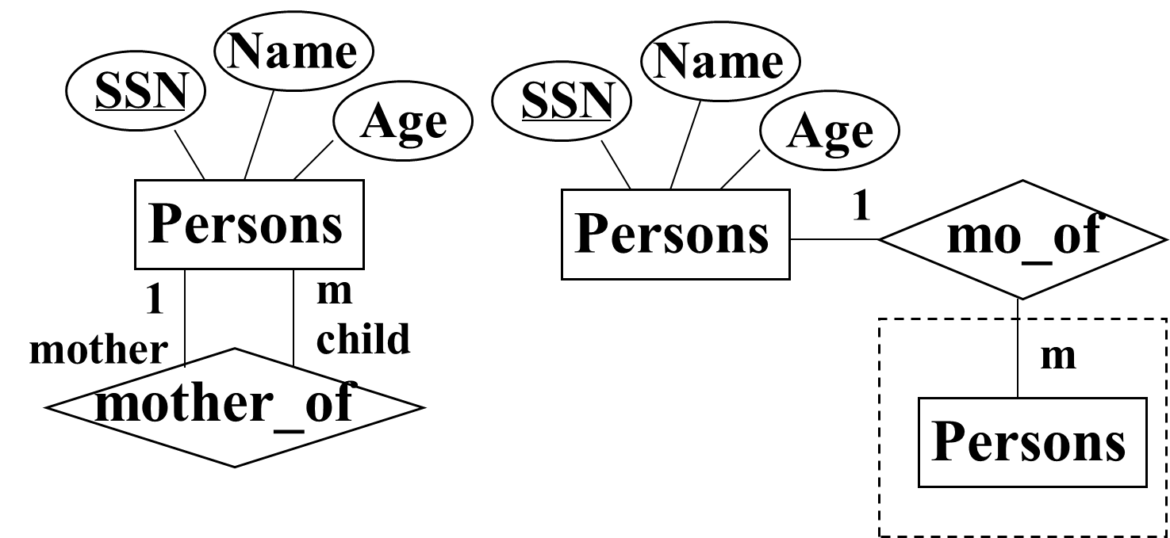
Example of mapping 1:N recursive relationship:
Person (SSN, Name, Age, Mother_SSN)

Slide 28
More Mapping Examples
“Company” Database

Slide 29
Example 1 (1:1 Relationship)
SSN
Name
Dnumber
Dname
Employee
1
Manages
1
Department
Employee
Department
SSN | Name
1 | Ahmad
2 | Kamal
3 | Sara
Dnumber | Dname | MgrSSN
1 | CS | 3
2 | QA | 2
Primary Key
Primary Key
Foreign Key

Slide 30
Example 2 (1:N Relationship)
SSN
Name
Dnumber
Dname
Employee
N
Works_in
1
Department
Employee
Department
SSN | Name | Dno
1 | Ahmad | 2
2 | Kamal | 1
3 | Sara | 1
Dnumber | Dname
1 | CS
2 | QA
Primary Key
Foreign Key
Primary Key

Slide 31
Example 3 (M:N Relationship)
SSN
Name
Pnumber
Pname
Employee
M
Works_on
N
Project
Employee
Works_on
Project
SSN | Name
1 | Ahmad
2 | Kamal
3 | Sara
SSN | Pno
1 | 10
1 | 30
2 | 20
3 | 30
Pnumber | Pname
10 | Abdali
20 | Jaleel
30 | Shaheq
Primary Key
Primary Key
Foreign Key
Foreign Key

Slide 32
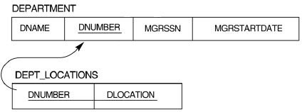
Important Notes
In all new relations, underline the attributes that form primary keys.
In a primary/foreign key relationship:
  Draw an arrow that connects each foreign key to the primary key attribute that it came from. The arrow points to the primary key.
  Example

Slide 33
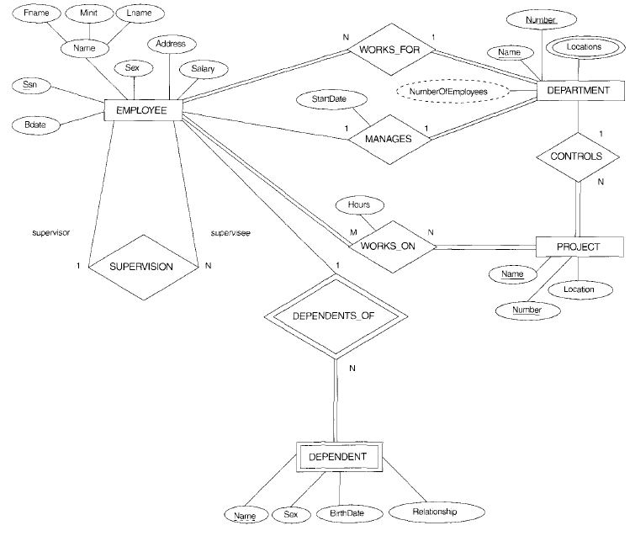
ERD for the Company Database

Slide 34
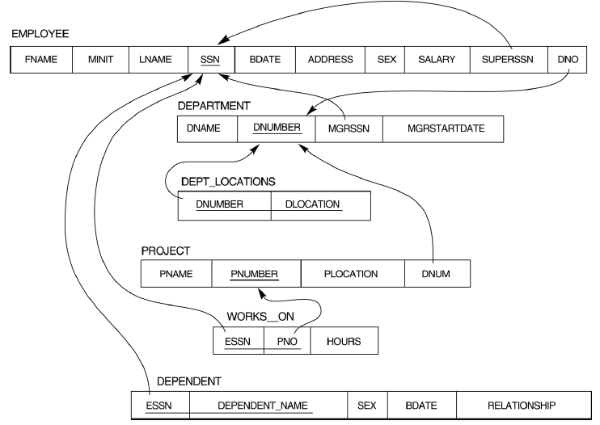
This relational DB schema is the result of mapping company ERD

Slide 35
Summary
ER-to-Relational Mapping Algorithm
  Step 1: Mapping of Regular Entity Types
  Step 2: Mapping of Weak Entity Types
  Step 3: Mapping of Binary 1:1 Relation Types
  Step 4: Mapping of Binary 1:N Relationship Types.
  Step 5: Mapping of Binary M:N Relationship Types.
  Step 6: Mapping of Multivalued attributes.
  Step 7: Mapping of Composite Attributes.
  Step 8: Mapping of N-ary Relationship Types.
  Step 9: Mapping of Recursive Relationship Type.
Complete mapping process requires completing all the previous steps.
Derived attributes are excluded from mapping because they are not stored in the Database.

Slide 36
Create a relation for each strong entity type
  include all simple attributes
  choose a primary key
2. Create a relation for each weak entity type
  include primary key of owner (a FK - foreign key)
  owner’s PK + partial key becomes PK
3. For each binary 1:1 relationship choose an entity
  include the other’s PK in it as a FK.
  include any attributes of the relationship
4. For each binary 1:N relationship, choose the n-side entity
  include a FK w.r.t the other entity.
  include any attributes of the relationship

Slide 37
5. For each binary M:N relationship, create a relation for the relationship
  include PKs of both participating entities and any attributes
  of the relationship
  PK is the concatenation of the participating entities’ PKs
6. For each multi-valued attribute, create a new relation
  include the PK attributes of the entity type
  PK is the PK of the entity type and the multi-valued attribute
7. For each composite attribute
  include only the simple attributes (of the composite attribute) to the same entity type relation that it belongs to

Slide 38
8. For each n-ary relationship, create a relation for the relationship
  include PKs of all participating entities and any attributes of
  the relationship
  PK may be the concatenation of the participating entity PKs
  9. For each recursive relationship,
  Transform the recursive relationship into a binary relationship
  Apply the rules for transforming binary relationships
  Derived attributes are excluded from mapping because they are not stored in the Database.

Slide 39
THE END

